Slide 1




STATE
OF THE
PENNY
2023

Slide 2

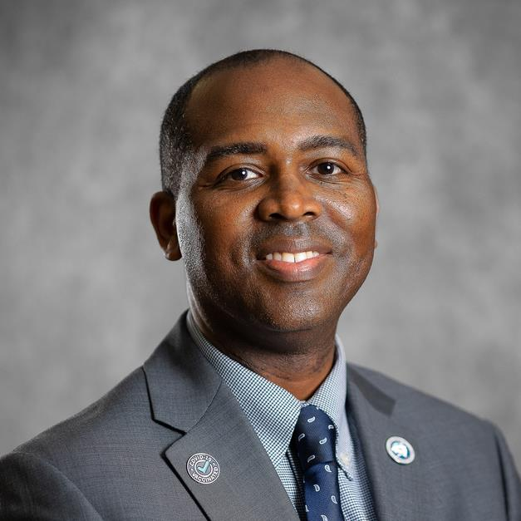
Leonardo Brown
Richland County Administrator

Slide 3
Welcome

Slide 4
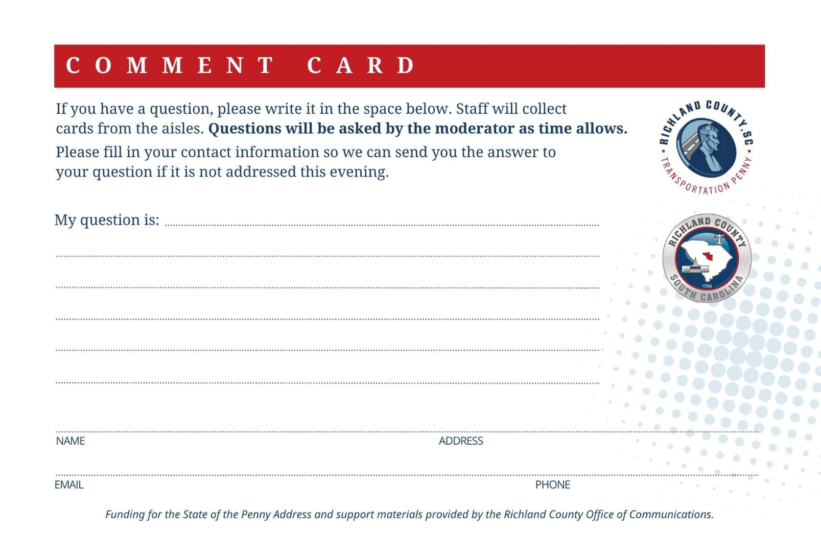
Submit Your
Questions

Slide 5

stateofthepenny.com

Slide 6
Media Questions

Slide 7

Your Opinion Counts.

Slide 8
STATE
OF THE
PENNY
2023

Slide 9
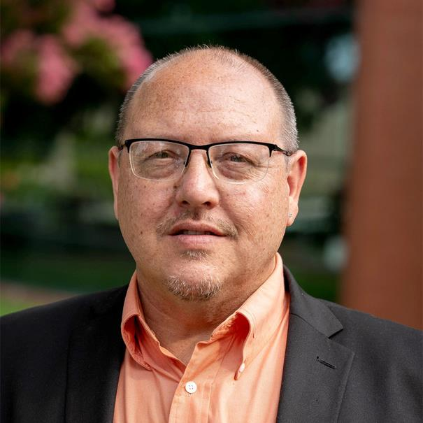
John Black
Chair, Transportation Penny Advisory Committee
(TPAC)

Slide 10
Transportation Penny
Advisory Committee
Richland County Council has prescribed the following powers and duties to the TPAC:
Provide a recommendation on any modification to the penny funded transportation project list not consistent with the generic description of the project (such as the addition of new projects not currently on the projects list, etc.)
Recommend any reordering of the project list priorities
Provide quarterly reports to each respective jurisdiction to which Committee members are appointed
Review the proposed scope of services for the Request for Proposals (RFP) for
the Program Management Team and to make recommendations as needed

Slide 11
Transportation Penny
Advisory Committee
Richland County Council has prescribed the following powers and duties to the TPAC:
Make recommendations for a financial review of the Transportation Penny as needed. (It is important to note there is an annual financial audit of the program)
Make recommendations to the Board of Directors of Central Midlands
Regional Transit (The COMET)
Perform other duties as assigned by Richland County Council

Slide 12


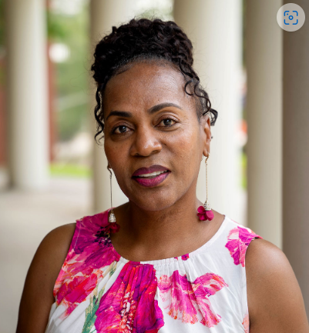

Eva Prioleau
Vice Chair, Transportation Penny Advisory Committee
(TPAC)

Slide 13
Transportation Penny
Advisory Committee
TPAC Meetings
TPAC meets at 4 p.m. on the third Monday of every month; meetings are open to the public
Meetings are streamed on the County’s YouTube channel
Meeting announcements are posted on the
Transportation Penny website: RichlandPenny.com
Email public questions and comments to TPAC@richlandcountysc.gov

Slide 14
Transportation Penny
Advisory Committee
TPAC Municipalities
Arcadia Lakes
Blythewood
Columbia
Eastover
Forest Acres
Irmo
Richland County
Ex Officio

Slide 15
STATE
OF THE
PENNY
2023

Slide 16
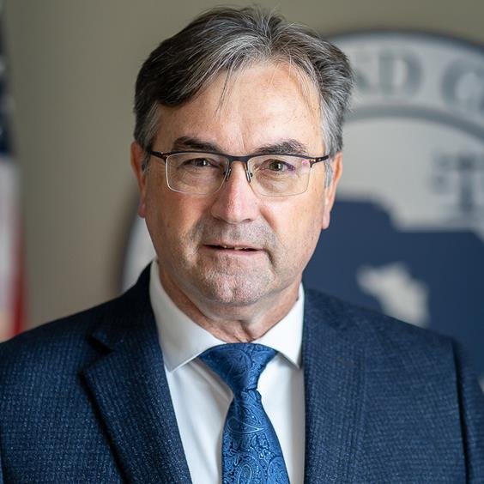
Presenter
Michael Maloney
Director, Richland County Public Works
& Transportation Penny Department

Slide 17
Facts & Figures
The 1% Sales Tax
Approved in November 2012 by Referendum
Tax collection began in May 2013
Maximum Collection: 22 years or when $1.07 billion is achieved, whichever comes first
County Finance Department predicts $1.07 billion will be collected by December 2025 (current collection rate basis w/minor growth)
The collection period is 12.5 years.

Slide 18

Facts & Figures
Current Status
We are 10.6 years into the program - 48% of 22 years
Penny revenue is currently $710 million - 66% achieved
Additional grant funding of $35.5M has extended program funding to $1.105 billion
Project budgets currently total $555M - 52.0% achieved
Scheduled projects continue until the fund is fully used.

Slide 19
Revenue Update
FY14 – FY23
Transportation Penny Tax | $ 710,324,258
Interest from State | $ 2,593,503
Interest earned by County | $ 15,351,414
Miscellaneous Revenue | $ 1,928,337
General Fund Payment | $ 16,538,255
Finance Cost | $ (5,702,370)
Grant Funds | $ 30,288,964
Total Revenue | $ 771,322,361

Slide 20
Expenditure Update
FY14 – FY23
 | 2014 | 2015 | 2016 | 2017 | 2018 | 2019 | 2020 | 2021 | 2022 | 2023 | Total
ROADWAY | 6,673,654 | 11,026,578 | 30,208,200 | 60,471,654 | 68,580,416 | 45,705,386 | 29,902,322 | 22,985,306 | 17,416,838 | 22,715,916 | 315,686,270
BIKE/PED | 0 | 972,299 | 3,597,380 | 2,327,625 | 5,235,180 | 5,476,312 | 2,718,151 | 3,173,285 | 1,263,959 | 996,247 | 25,760,438
COMET | 14,924,544 | 15,122,903 | 15,302,720 | 16,779,545 | 17,925,481 | 24,361,563 | 19,670,586 | 22,256,786 | 24,591,348 | 28,858,739 | 199,794,215
PERSONNEL | 0 | 0 | 0 | 0 | 0 | 0 | 404,662 | 508,868 | 529,989 | 611,083 | 2,054,602
ADMIN | 562,333 | 4,977,232 | 3,174,634 | 3,074,929 | 0 | 0 | 0 | 0 | 0 | 0 | 11,789,128
TOTAL | 22,160,531 | 32,099,012 | 52,282,934 | 82,653,753 | 91,741,077 | 75,543,261 | 52,695,721 | 48,924,245 | 43,802,134 | 53,181,985 | 555,084,653

Slide 21
Project Funding
PROJECT CATEGORY | Original Fund | Current FUND | EXPENDED TO DATE | REMAINING FUND | FORECAST
ROADWAY PROJECTS | $ 656,020,644 | $ 640,923,082 | $ 317,274,529 | $ 323,648,553 | $ 348,500,000
PROJECT RESERVE |  | $ 47,500,000 | $ | $ 47,500,000 | $ 22,648,553
TOTAL BIKE/PED/GREENWAY | $ 80,888,356 | $ 84,006,038 | $ 26,226,781 | $ 57,779,257 | $ 36,000,000
COMET EXPENDITURES | $ 300,991,000 | $ 300,991,000 | $ 199,794,215 | $ 101,196,785 | $ 101,196,785
PROGRAM RESERVE | $ 32,100,000 | $ 62,809,139 | $ 11,789,128 | $ 51,020,011 | $
TOTAL PROGRAM | $ 1,070,000,000 | $ 1,136,229,259 | $ 555,084,653 | $ 581,144,606 | $ 508,345,338

Slide 22
Current Funding
2024
Roadway | 178,617,0740
Bike/Ped/Greenway | 37,844,3620
 | 216,461,4360

Slide 23
Project Development Status
Percent completed by category
Road Widening
Intersections
Special Projects
Dirt Road Paving
Resurfacing
Greenways
Bikeways
Sidewalks
Ped Improvements
The Comet
44%
70%
52%
47%
80%
55%
90%
50%
100%
66%

Slide 24
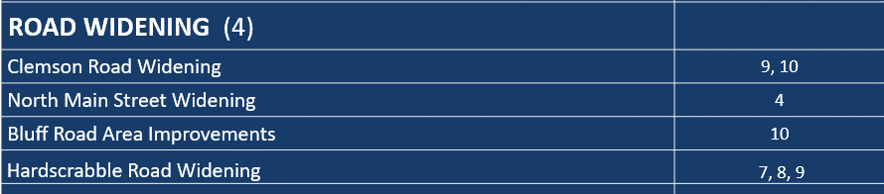
Completed Projects
Road Widening
3

Slide 25
Completed Projects
Intersections
INTERSECTIONS (11)
Clemson Rd. & Rhame Rd./North Springs Rd. | 8, 9
Broad River Rd. and Rushmore Rd. | 4
Farrow Rd. and Pisgah Church Rd. | 7
North Springs Rd. and Risdon Way | 8, 9
Summit Pkwy and Summit Ridge Rd. | 8, 9
Kennerly Rd. & Coogler Rd./Steeple Ridge Rd. | 1
Wilson Blvd. and Pisgah Church Rd. | 7
Wilson Blvd. and Killian Rd. | 7
North Springs Rd. and Harrington Rd. | 8, 9
N Main St. and Monticello Rd. | 4
Screaming Eagle Rd. and Percival Rd. | 10

Slide 26
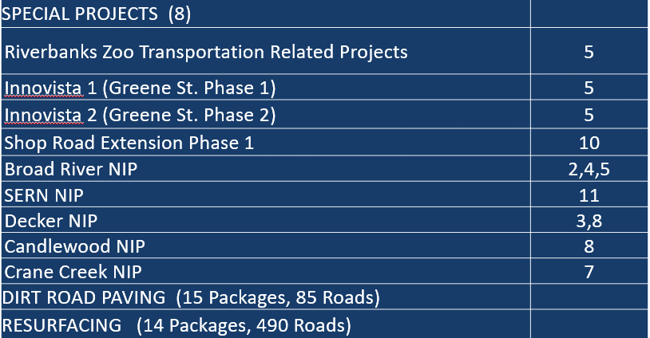
Completed Projects
Special Projects

Slide 27
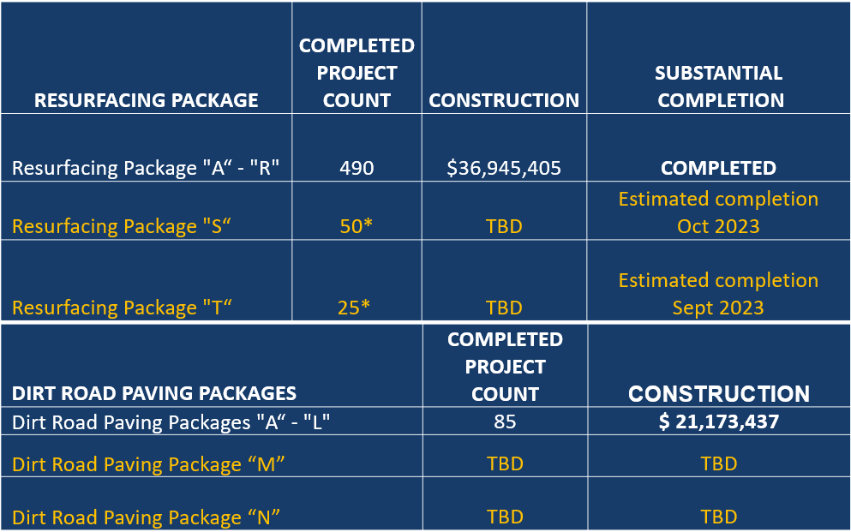
Completed Projects
Resurfacing & Dirt Road Paving
$3,214,303
Completing Punch List
Completing Punch List
$1,921,733
Dirt Road Paving Package “M”
4
$ 1,111,434
3
$ 1,642,297

Slide 28
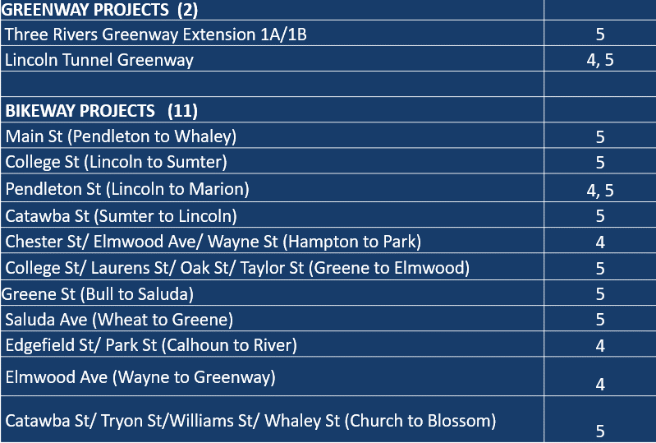
Completed Projects
Greenways & Bikeways

Slide 29
Completed Projects
Sidewalks
Clemson Rd Package S-10 | 9,10
Colonial Dr | 4
Columbiana Dr | 2
Broad River Rd (Greystone to Broad River Bridge) | 4, 5
Blossom St | 5
Gervais St (west of Gist to Gist) | 5
Blythewood Rd (I-77 to Main) | 2
Gervais St (Gist to Huger) | 5
Park St (Gervais to Senate) | 5
Polo Rd (Mallet Hill to Alpine) | 8, 9, 10
Bratton St (King to Maple) | 5
Calhoun St (Gadsden to Wayne) | 4
Franklin St (Sumter to Bull) | 4
Grand St (Shealy to Hydrick) | 4
Jefferson St (Sumter to Bull) | 4
Laurel St (Gadsden to Pulaski) | 4, 5
Lincoln St (Heyward to Whaley) | 5
Lyon St (Gervais to Washington) | 5

Slide 30
Completed Projects
Sidewalks Cont’d
Magnolia St (Two Notch to Pinehurst) | 3
Maple St (Kirby to Gervais) | 6
Mildred Ave (Westwood to Duke) | 4
Royster St (Capers Ave) | 10
School House Rd (Two Notch to Ervin) | 3
Senate St (Gladden to King) | 5, 6
Tryon St (Catawba to Heyward) | 5
Wayne St (Calhoun to Laurel) | 4, 5
Wildwood Ave (Monticello to Ridgewood) | 4
Wiley St (Superior to Edisto) | 10
Windover St (Two Notch to Belvedere) | 3
Harrison Rd (Two Notch to Forest) | 3
Koon (Malinda to Farmview) | 3
Pelham (Gills Creek to Garners Ferry) | 6
Pinehurst (Harrison to Forest) | 3
Veterans (Garners Ferry to Wormwood) | 11
Veterans (Coachmaker to Coatsdale) | 6, 11

Slide 31
Completed Projects
Pedestrian Improvements
PEDESTRIAN IMPROVEMENT PROJECTS (16) | District
Assembly and Calhoun | 4
Assembly and Gervais | 4, 5
Assembly and Laurel | 4
Assembly and Washington | 4, 5
Blossom and Saluda | 5
Elmwood and Park | 4
Main and Calhoun | 4
Rosewood and Beltline | 5, 6
Rosewood and Harden | 5
Rosewood and Holly | 5
Rosewood and Marion | 5, 10
Rosewood and Ott | 5
Rosewood and Pickens | 5, 10
Two Notch and Brickyard | 8, 9
Two Notch and Maingate/Windsor Lake | 3
Two Notch and Sparkleberry | 9

Slide 32
Remaining Projects
Road Widening
WIDENINGS | DISTRICT | PHASE
Hardscrabble Road Widening | 7, 8, 9 | SCDOT
Leesburg Road Widening | 11 | SCDOT
Bluff Road Widening Phase 2 | 10 | Design
Shop Road Widening | 10 | Design
Atlas Road Widening | 10, 11 | RW
Pineview Road Area Improvements | 10, 11 | Design
Blythewood Road Widening (Syrup Mill Road to I-77) | 2, 7 | Const.
Broad River Road Widening | 1 | RW
Spears Creek Church Road Widening | 9, 10 | Design
Lower Richland Boulevard Widening | 11 | Design
Polo Road Widening | 8, 9, 10 | Design
Blythewood Road Area Improvements | 2, 7 | Design

Slide 33
Remaining Projects
Intersections
INTERSECTION IMPROVEMENTS
Clemson Rd. and Sparkleberry Ln. | 9, 10 | Design
Bull St. and Elmwood Ave. | 4 | Construction
Garners Ferry Rd. and Harmon Rd. | 11 | Construction

Slide 34
Remaining Projects
Special Projects & County Maintained
SPECIAL PROJECTS | DISTRICT | PHASE
Innovista 3 (Williams St.) | 5 | NS
Shop Road Extension Phase 2 | 10 | Design
Kelly Mill Road | 2, 9 | Design
Commerce Drive Improvements | 10 | NS
SERN NIP – Rabbit Run Sidewalk | 11 | Various
Decker NIP (Ready to Start Brookfield and Hunt Club Road SW) | 8 | Various
Crane Creek NIP | 7 | Design
Trenholm/New Castle NIP | 3 | Design
Broad River Corridor NIP | 4, 5 | RW
PROJECT RESERVE
DIRT ROAD PAVING |  | Various
RESURFACING |  | Various
PROGRAM (traffic studies / plans / mitigation bank) |  | Various

Slide 35
Remaining Projects
Greenways
GREENWAY PROJECTS | DISTRICT | PHASE
Three Rivers Greenway Extension, Phase 2 | 5 | Design
Gills Creek (Fort Jackson Blvd to Mikel Ln) | 6, 10 | ROW
Smith/Rocky Branch | 4 | ROW
Crane Creek | 4 | Design
Columbia Mall Greenway | 3, 8 | Design
Polo Road / Windsor Lake Boulevard Connector | 3, 8 | Design

Slide 36
Remaining Projects
Bikeways
BIKEWAY PROJECTS
Signs and Sharrows (City of Columbia IGA) |  | City
Road Diet - Calhoun St | 4 | City
Road Diet - Pickens, Washington, Wayne St | 4, 5 | City
Restripe/Narrow - Whaley St (Main to Pickens) | 5 | SCDOT
Restripe/Narrow - Alpine Rd (changed to sidewalks) | 3, 8, 10 | Const
Restripe/Narrow - Beltline Blvd (SCDOT resurfacing) | 4 | SCDOT
Restripe/Narrow - Blythewood Rd - (changed to SUP) | 2, 7 | Const
Restripe/Narrow - Clemson Rd (Longtown/Brookhollow)(SCDOT) | 7, 8 | SCDOT
Restripe/Narrow - Clemson Rd (Brookhollow/Summit)(SCDOT) | 8 | SCDOT
Restripe/Narrow - Beltline/Devine(Rosewood/Chateau)(SCDOT) | 6 | SCDOT
Wide SW - Clemson complete w/Intersection Project @Sparkleberry) | 9 | NS

Slide 37
Remaining Projects
Sidewalks
SIDEWALK PROJECTS | DISTRICT | PHASE
Sunset Dr. (SC 16) - Elmhurst Rd. (S-1405) to River Dr. (US 176) | 4 | RW
Alpine Rd. (S-63) - Two Notch Rd. (US 1) to Percival Rd. (SC 12) | 3, 8, 10 | RW
Percival Rd. (SC 12) - Forest Dr. (SC 12) to Decker Blvd. (S-151) | 6 | RW
Fort Jackson Blvd (SC 760) - Wildcat Rd. (US 76) to I-77 | 6 | NS
Prospect Road (Wilmot to Yale) | 5 | NS
Shandon St sidewalk (Rosewood to Heyward) | 5 | NS
Shandon St sidewalk (Wilmot to Wheat) | 5 | NS
Email: transportationpenny@richlandcountysc.gov

Slide 38
STATE
OF THE
PENNY
2023

Slide 39

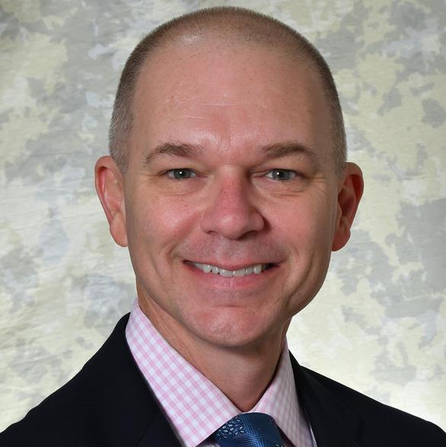

Presenter
John Boylston
Director of Preconstruction,
South Carolina Department of Transportation

Slide 40

≈$5B
As of today, almost $5 billion under contract
2013
$1B
2009
2013
2017
2023

Slide 41
Year 6 of Agency’s Strategic 10-Year Plan
More than $1B invested in Richland County
$666.2 Million
$121.2 Million
$313.8 Million
$17.1 Million

Slide 42
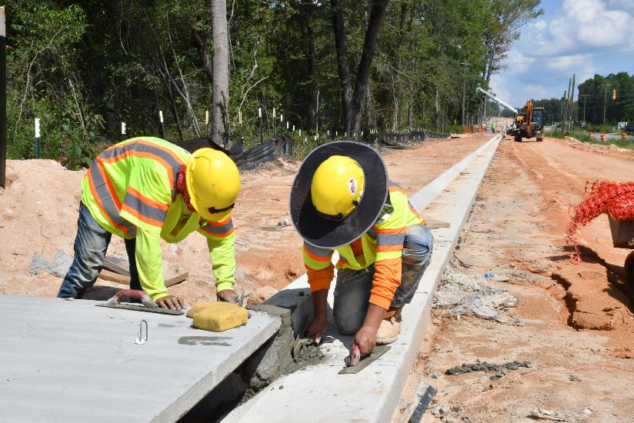
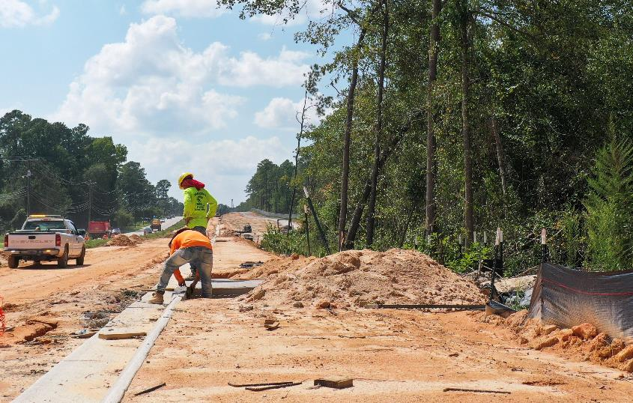
Hardscrabble Road Widening
Total Construction Cost - $97.5M
Richland County Contribution - $29.8M
Estimated Completion – Summer 2024
Leesburg Road Widening
Total Construction Cost - $60.8M
Richland County Contribution - $4M
Estimated Completion - Fall 2025

Slide 43
STATE
OF THE
PENNY
2023

Slide 44
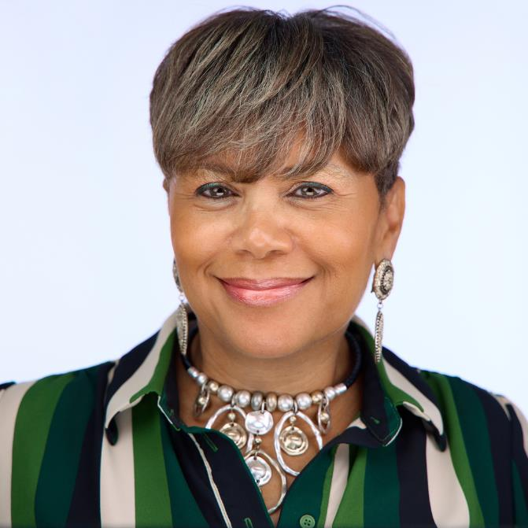
Presenter
Pamela Green
Interim Manager, Richland County Office of
Small Business Opportunity

Slide 45

History & Overview
Richland County
Small Local Business Enterprise
(SLBE) Program
Established September 17, 2013

Slide 46
History & Overview
SLBE
To provide a race- and gender-neutral procurement tool for the County to ensure all segments of local business have a reasonable and significant opportunity to participate in County contracts for construction, architectural and engineering services, professional services, non-professional services and commodities
To foster effective, broad-based competition from all segments of the vendor community
To provide avenues for the development of new capacity
and new resources of competition for contracts from small and locally based businesses

Slide 47
History & Overview
Richland County
Office of Small Business Opportunity
(OSBO)
Established July 15, 2014

Slide 48
History & Overview
OSBO
Created a Director position to manage the fulfillment of small-business programs, including SLBE programs and business development activities
Provides certification to small local businesses in Richland County
Provides technical workshops and training on various topics such as contracting, investor and loan options, marketing, branding and networking, development of business plans, and establishing credit
Plans and implements community outreach events

Slide 49
History & Overview
OSBO
Initially funded in 2014 by the Transportation Penny program with planned phases for transitioning the budget to the general fund.
Became fully funded by the general fund in 2017

Slide 50
Certified SLBEs by Industry

Slide 51
Certified SLBEs by Ethnicity

Slide 52
Certified SLBEs by Gender

Slide 53
SLBE Awards & Payments
Transportation Penny Projects
To date $88,103,242 has been awarded and paid to SLBE’s,
tracked through our B2G System for the following projects
as of October 2023:
Dirt Road Paving
Sidewalk and Pedestrian Improvements
Resurfacing Projects
Intersection Improvements
Drainage Improvement Projects

Slide 54
SLBE Participation Goals
2018 - 2023
The Office of Small Business Opportunity (OSBO) has set project goals
with SLBE participation on approximately 40+ projects.
Goals have ranged from 3% to 100%, with SLBEs performing as sub
and/or prime contractors depending on the project
  Sidewalk S-13 - 25%
  Decker Woodfield NIP - 25%
  Dirt Road Package K - 23%
100% participation goals, aka “sheltered market” projects represented
by an SLBE performing the work as a prime contractor
  Clemson Road Sidewalk
  Koon Road and Farmview Street
  Knollwood and Planters Drainage Improvement
Average goal set from 2018-2023 excluding “sheltered market”
projects was approximately 15%

Slide 55


Penny Testimonials
“Richland County’s Penny Tax program provides a more level playing field for the small local company by introducing the Small and Local Business Enterprises (SLBE).
“With the program, Chao and Associates had opportunities to be included in the first round of On Call Engineering Transportation (OET) as a sub-consultant for the prime firm. By gaining some experience working as a sub, we competed and were selected as a prime consultant in the second round. With projects under our belt, we now have a legitimate opportunity to compete for similar projects in Richland County.”

Slide 56

Penny Testimonials
“Prior to the SLBE program and advocacy of the Richland County OSBO, it was nearly impossible for small and emerging businesses to win government contracts with Richland County. But not anymore.
“The small businesses in our local community now have an advocate and a voice and a partner within the County Government under the Penny Transportation Roadway Program.”

Slide 57
STATE
OF THE
PENNY
2023

Slide 58
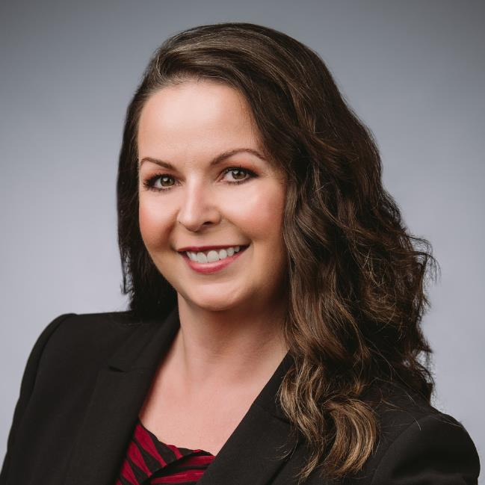
Presenter
Carrie Turner
Marketing Manager
Richland County Economic Development

Slide 59
Economic Development
$24 million extension of Shop Road
Extension created access, leading to more than $1B in industrial development

Slide 60
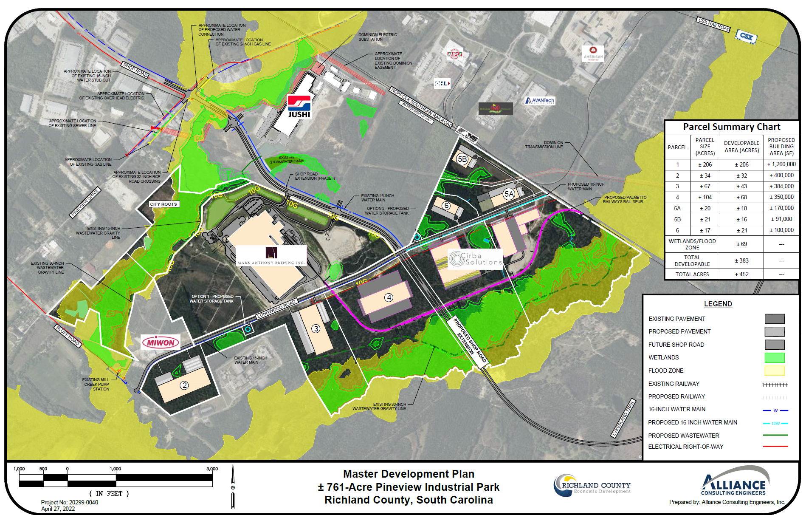
Economic Development

Slide 61

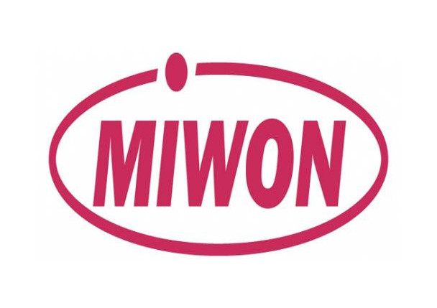
Pineview Industrial Park
CHINA JUSHI
$300M, 400 jobs
New; March 2016
Fiberglass manufacturing
MIWON SPECIALTY CHEMICALS
$19.5M, 25 jobs
New; January 2019
Specialty chemicals

Slide 62
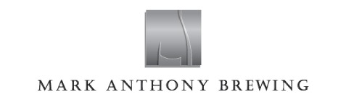

Pineview Industrial Park
MARK ANTHONY BREWING
$400M, 300 jobs
New; November 2020
Hard seltzer & beverage manufacturing
CITY ROOTS
$4.4M, 60 jobs
Expansion; July 2022
Microgreen Farming

Slide 63

Pineview Industrial Park
CIRBA SOLUTIONS
$323M, 310 jobs
New; March 2023
EV battery recycling

Slide 64
Economic Development
Other Developments
North Main Widening
Bull Street & Elmwood Avenue

Slide 65
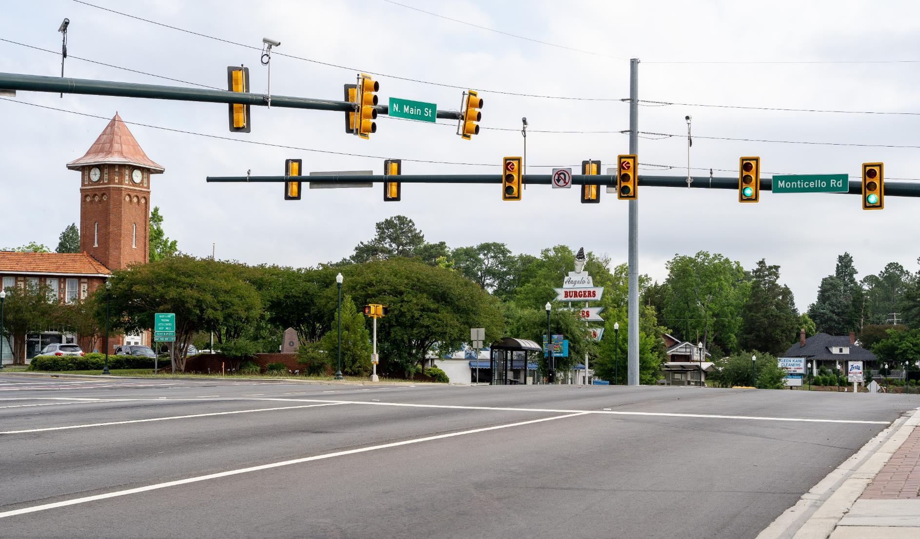
Economic Development
Main Street Widening

Slide 66
Economic Development
Main Street Widening
A multi-phase Penny Project
Widening and repaving
Improved intersections, particularly at North Main Street and Monticello Road
Imprinted and textured pavement stamping for designated crosswalks
Landscaping improvements
Street lighting to improve nighttime safety
Improved pedestrian routes
Overhead utilities relocated underground

Slide 67
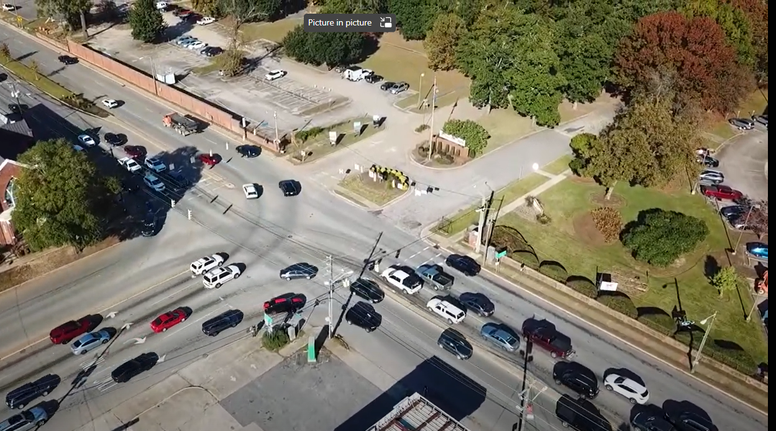
Economic Development
Bull Street & Elmwood Avenue Improvements

Slide 68
Economic Development
Bull Street & Elmwood Avenue
Lane addition to the eastbound side of Elmwood Avenue
Channelized southbound right-turn lane from Bull Street to Elmwood Avenue to improve traffic flow
Resurfacing and restriping roads
Improving drainage
Adding landscaping along Elmwood Avenue
Upgrading traffic signals
Constructing, removing and rebuilding concrete islands
Improving pedestrian crossings

Slide 69
STATE
OF THE
PENNY
2023

Slide 70
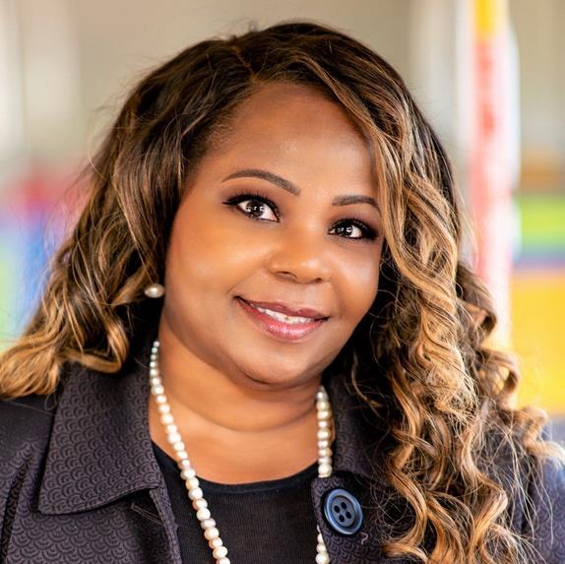
Presenter
Pamela Bynoe-Reed
Public Information Officer &
Director of Marketing and Community Affairs,
The COMET/Central Midlands Regional Transit Authority

Slide 71
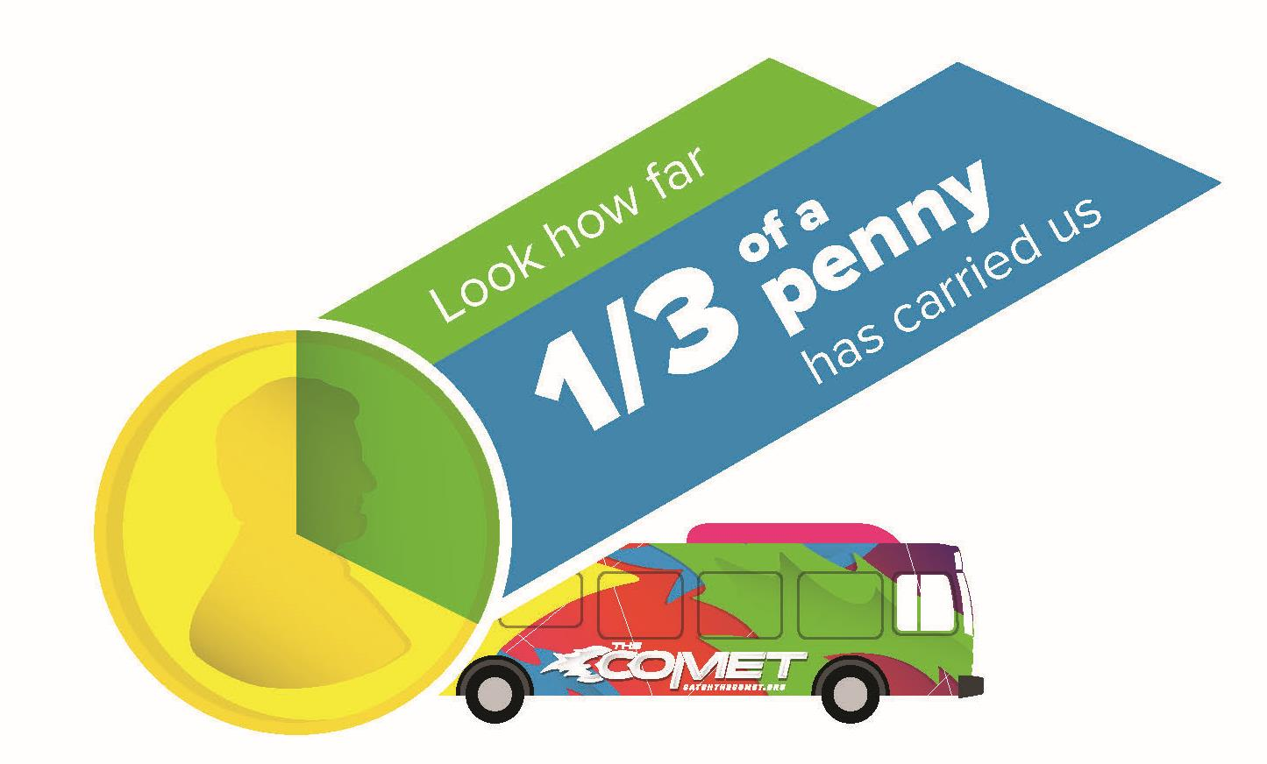

Slide 72
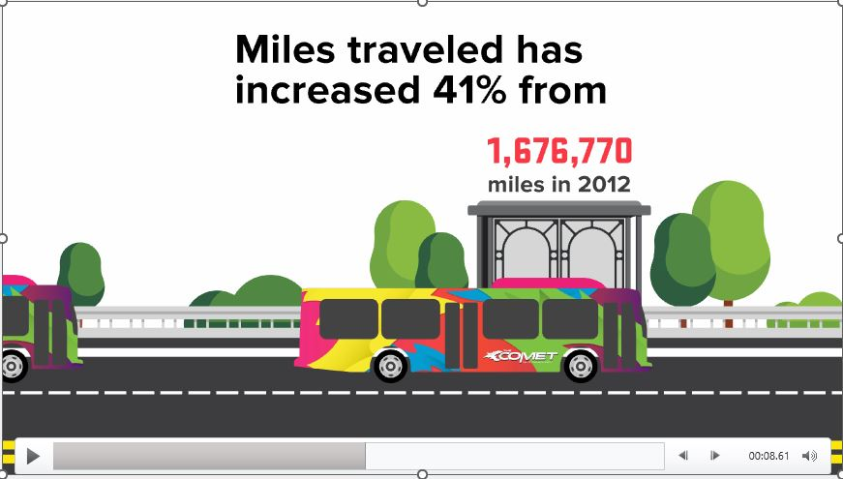

Slide 73
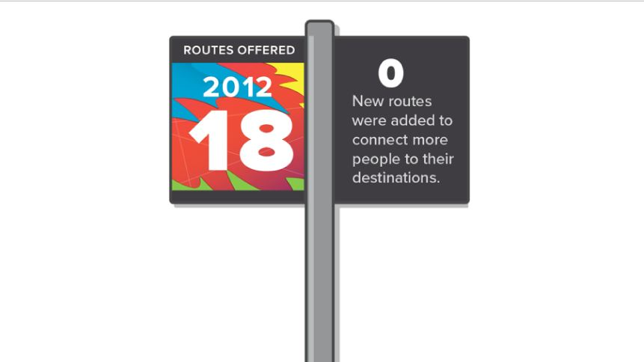

Slide 74
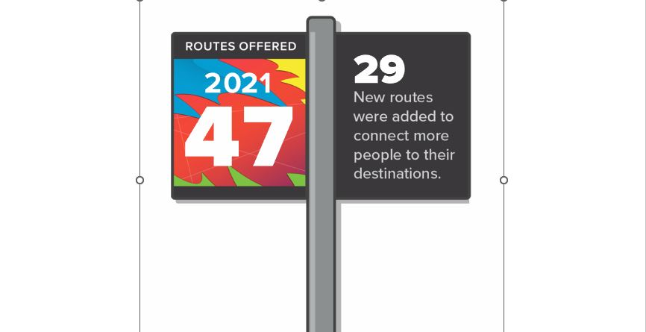

Slide 75
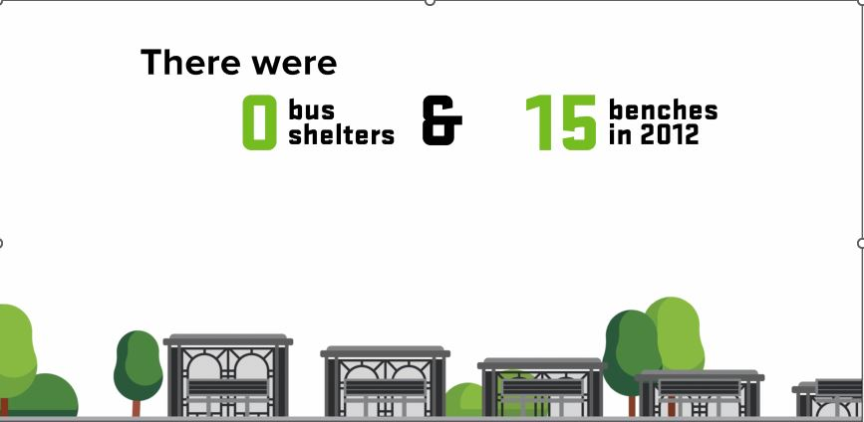

Slide 76
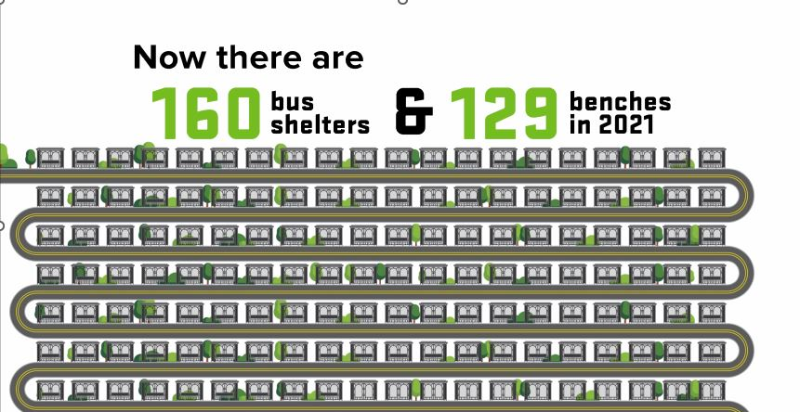

Slide 77
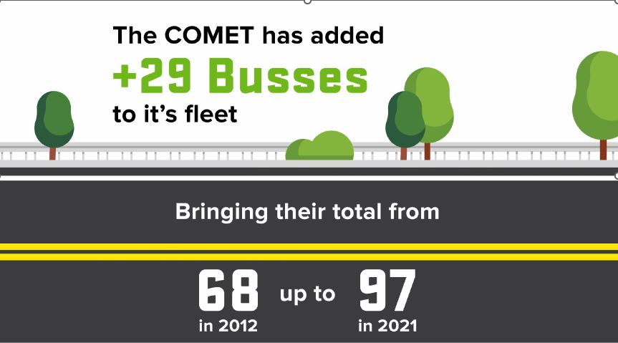

Slide 78
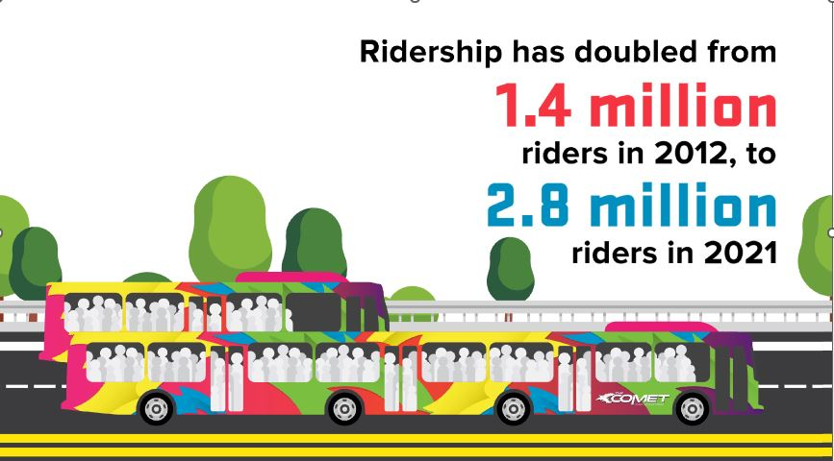

Slide 79
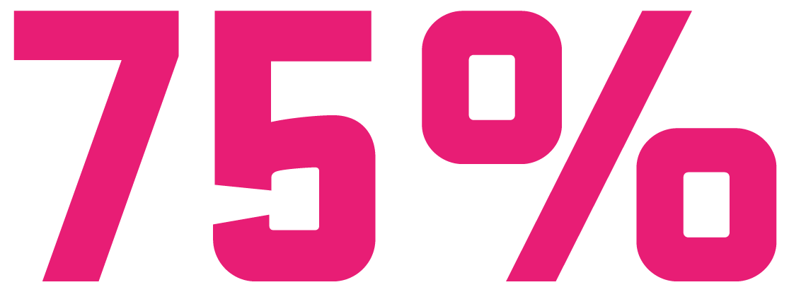
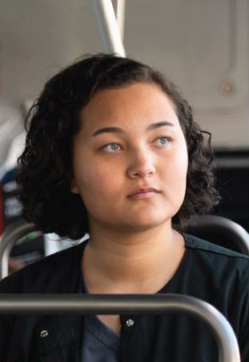
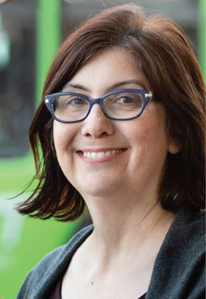
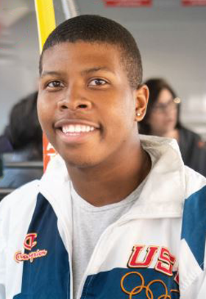
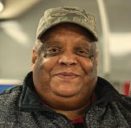
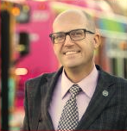
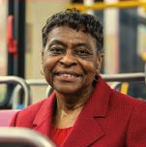
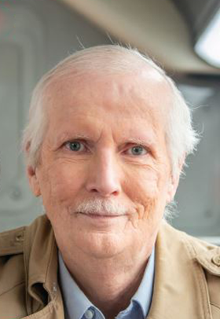
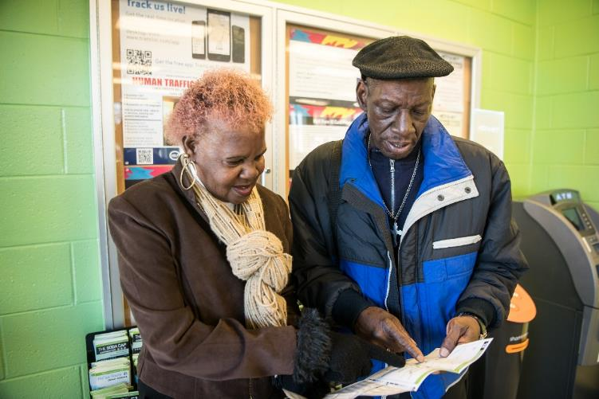
Real People, Real Riders
Access to Work, Food and Health

Slide 80
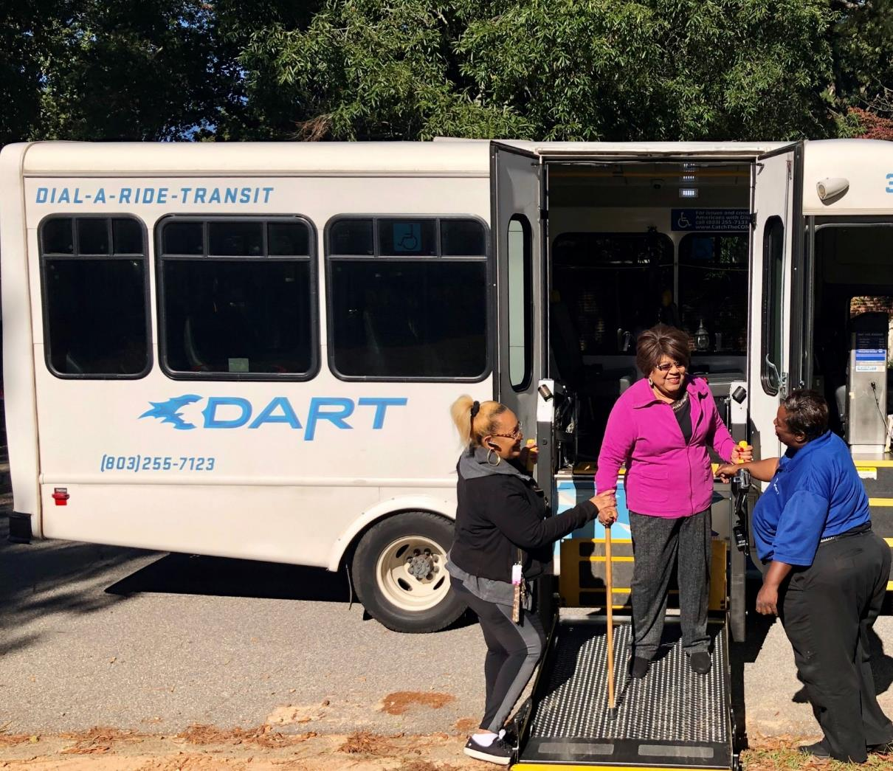
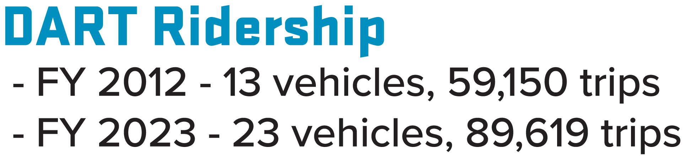
Real People, Real Riders – DART paratransit

Slide 81







Community Programs and Services Beyond the Road

Slide 82








Innovation to Serve ALL Our Community

Slide 83





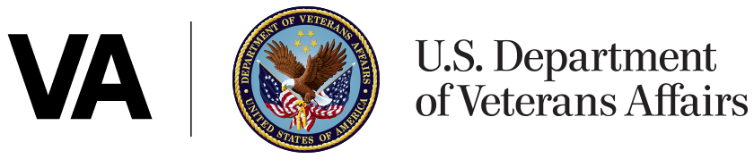
Innovation to Serve ALL Our Community

Slide 84
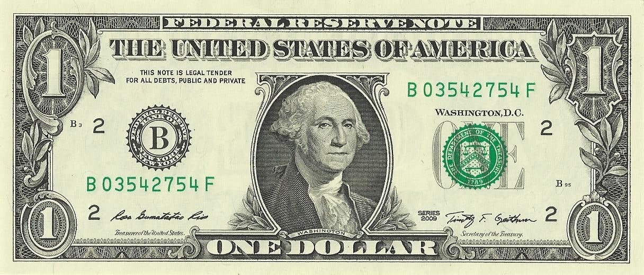

Federal Match
This Photo by Unknown Author is licensed under CC BY-SA

Slide 85
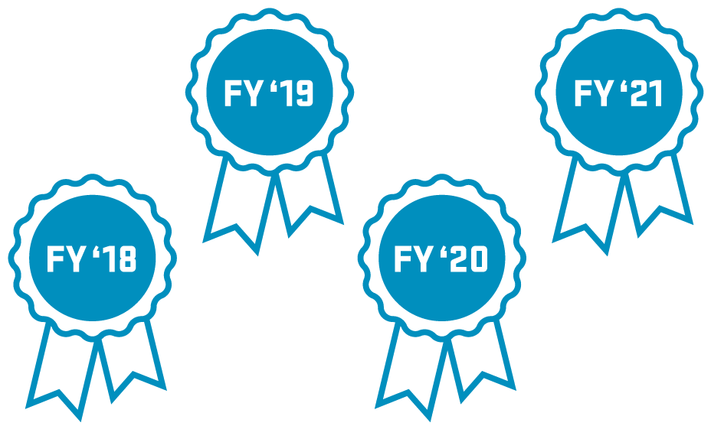

Excellence in Financial Management Award
‘22

Slide 86

Distinguished Budget Award

Slide 88
STATE
OF THE
PENNY
2023

Slide 89
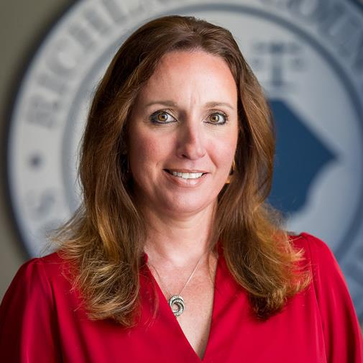
Moderator
Susan O’Cain
Director
Richland County Office of Communications

Slide 90
Community
Questions

Slide 91


Slide 92
STATE
OF THE
PENNY
2023

